Slide 1
Comprehensive Analysis of Factors Influencing Loan Status
Tran Quang Nam

Slide 2
Table of contents
01
02
03
04
05
Introduction
Data Understanding & Data Preparation
Exploratory Data Analysis
Feature Selection
& Modeling
Results and Future work

Slide 3

Purpose of the Analysis
Bank loan status refers to the current condition of loans issued by financial institutions, indicating whether borrowers are actively repaying their loans ('fully paid') or have failed to meet repayment obligations ('charged off’).
Understanding loan status is crucial for banks to manage credit risk, make informed lending decisions, and maintain financial stability.

Slide 4
01
Introduction

Slide 5
Introduction
Our problem
Banks are seeing a significant increase in non-performing loans, impacting their financial health and credit risk management strategies
Our idea
Develop a predictive model to identify and forecast which loan cases are likely to be fully paid and which are at risk of being charged off.

Slide 6
02
Data Understanding & Data Preparation

Slide 7
2.1. Data understanding
100,514
Entries
19
2
Columns
Types of data
(float, object)

Slide 8
2.1. Data understanding
Loan ID: Unique identifier for each loan.
Customer ID : Unique identifier for each customer
Loan Status : State of the loan
Current Loan Amount : Amount of the loan currently held by customer
Term : The duration of the loan (short/ long term)
Credit Score: The credit score of the customer at the time of loan application
Annual income : The annual income of customer
Years in current job : The number of yeas the customer has been in their current job
Purpose : Stated purpose of the loan
Home ownership The home ownership status of customer

Slide 9
2.1. Data understanding
11. Monthly debt obligations of the customer
12. Years in credit history : Number of yeas in the customer has had a credit history
13. Number of open account : The number of account customers have
14. Months since last delinquent : The number of months since the customer has lad delinquencies
15. Number of credit problem : the number of credit-related problem(late payment, bankrupt…)
16. Current credit balance : The current total balance of all credit accounts held by customers
17. Maximum open credit : The highest amount of money that customers can have
18. Bankruptcies : The number of bankruptcies by the customer
19. Tax Liens: The number of tax liens against the customer

Slide 10
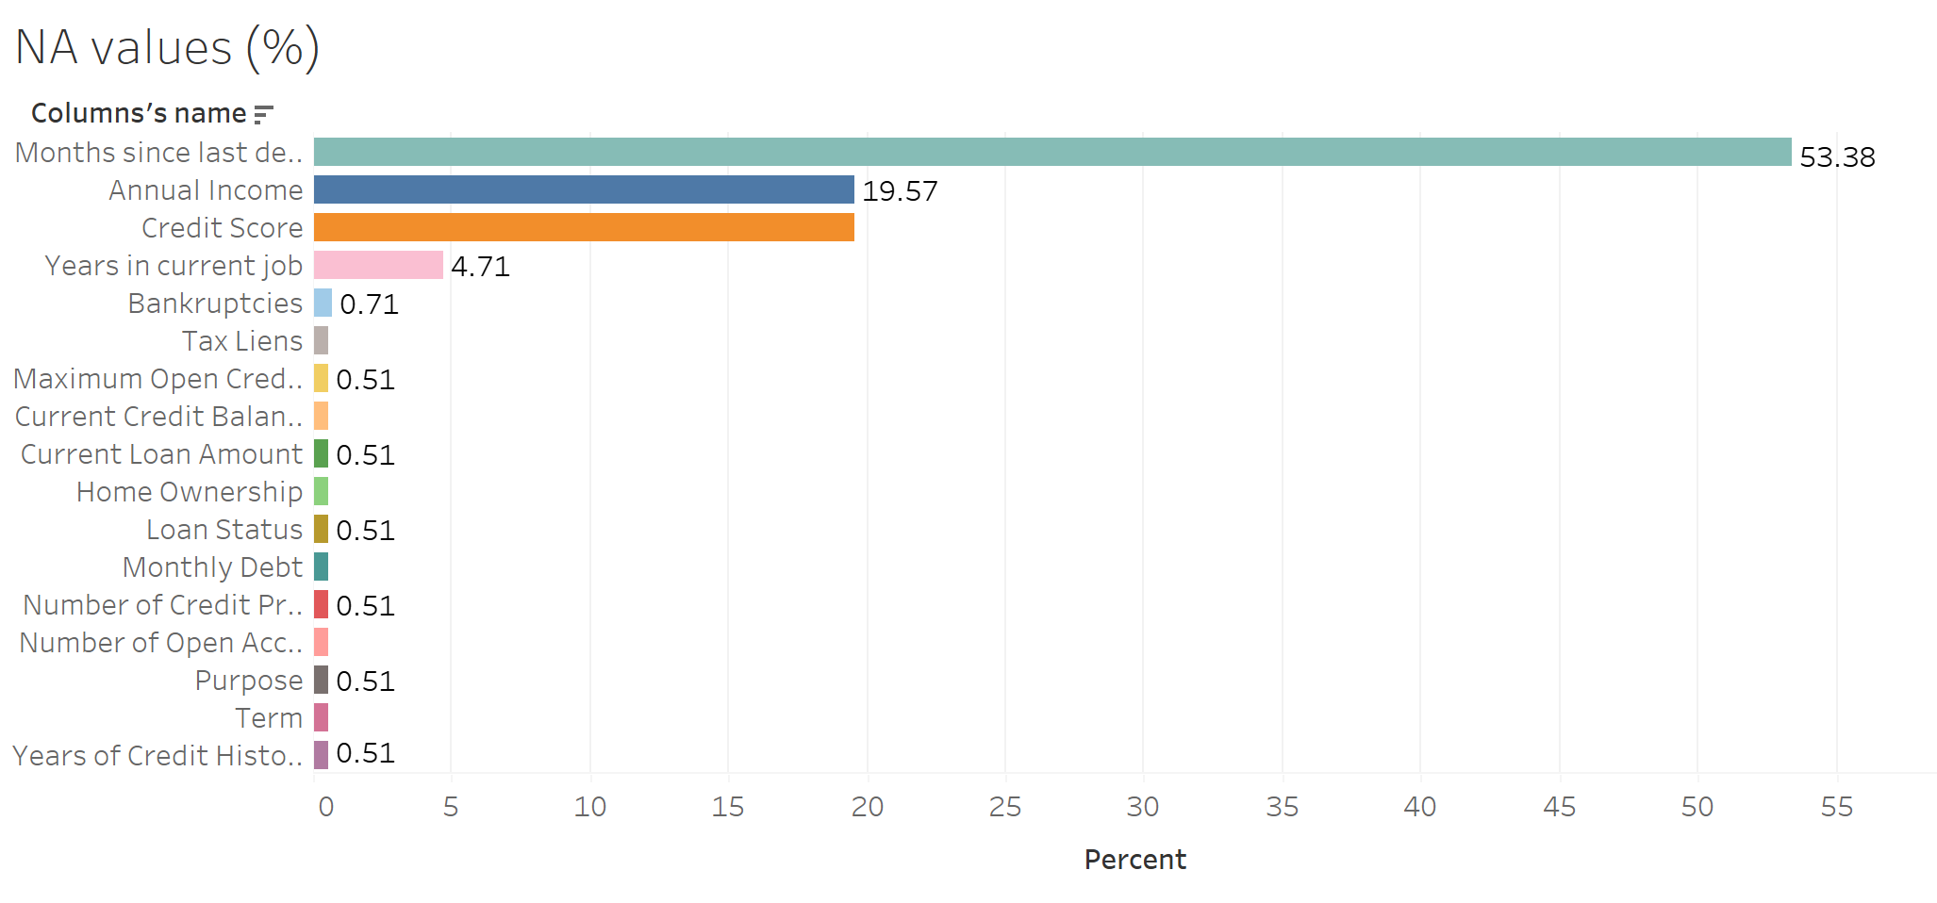
2.2. Data prepairation
2.2.1. In this part, we need to find out all the NA values, duplicate values, and outliers
Handle the NA values
Delete column with number of na values ​​greater than 50%
Delete rows with number of NA values below 1% (all of these rows is na values)
Fig1. NA plot

Slide 11
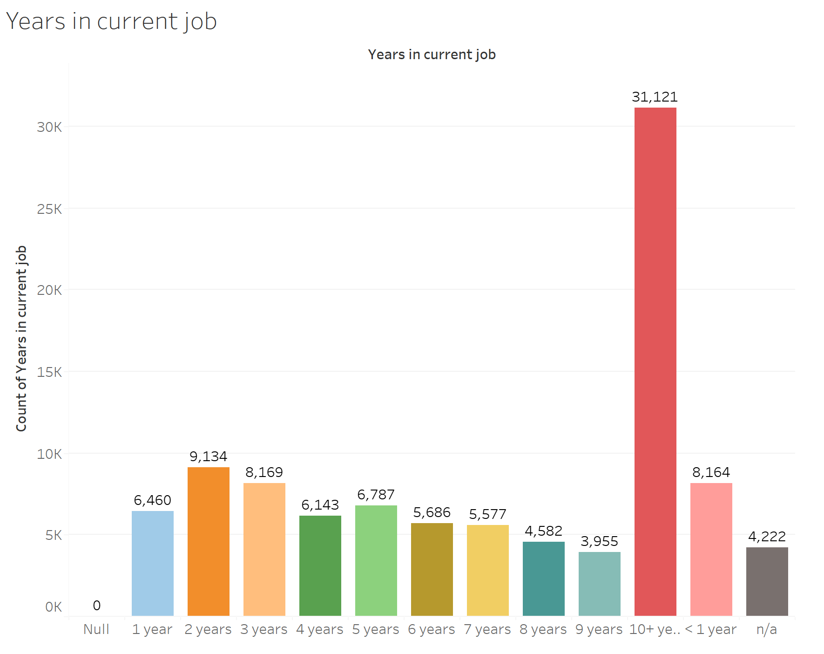
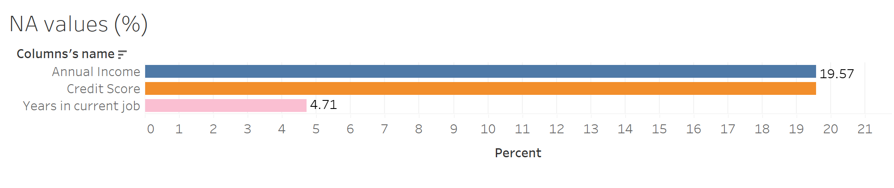
2.2. Data preparation
2.2.1. In this part, we need to find out all the NA values, duplicate values, and outliers
Fig 2. NA plot
Handle the NA values
Years in current job have the 4.71% of NA.
In Fig 3, 10+ years has the highest quantity. So we will fill na values with this
Fig 3. Years in current job plot

Slide 12
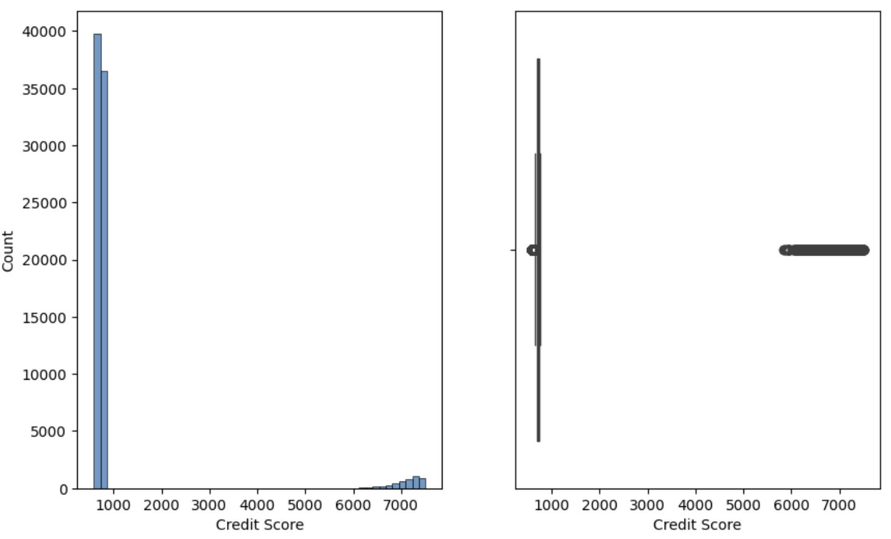
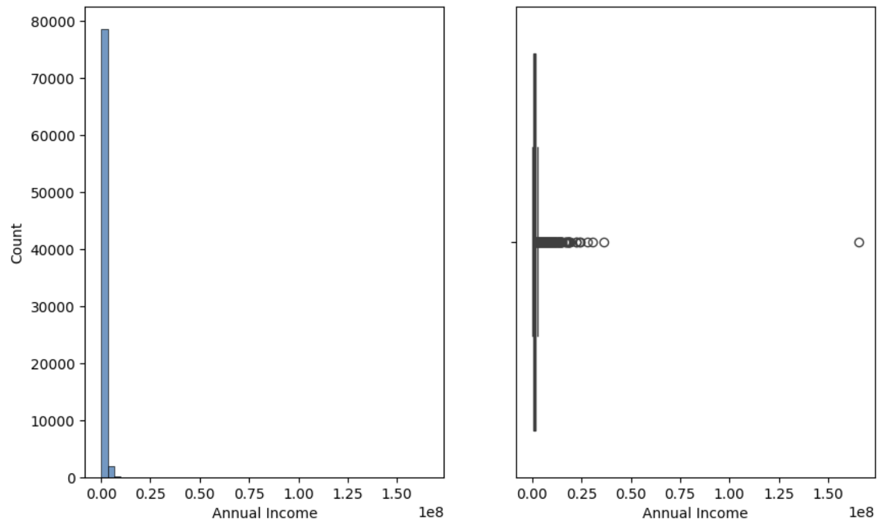
2.2. Data preparation
2.2.1. In this part, we need to find out all the NA values, duplicate values, and outliers
Fig 4. Distribution of Credit score
Fig 5. Distribution of Annual income
Handle the NA values
Credit score have a huge values of na (>19%) but Credit score have outliers, so we will fill na by median
Same for Annual income

Slide 13
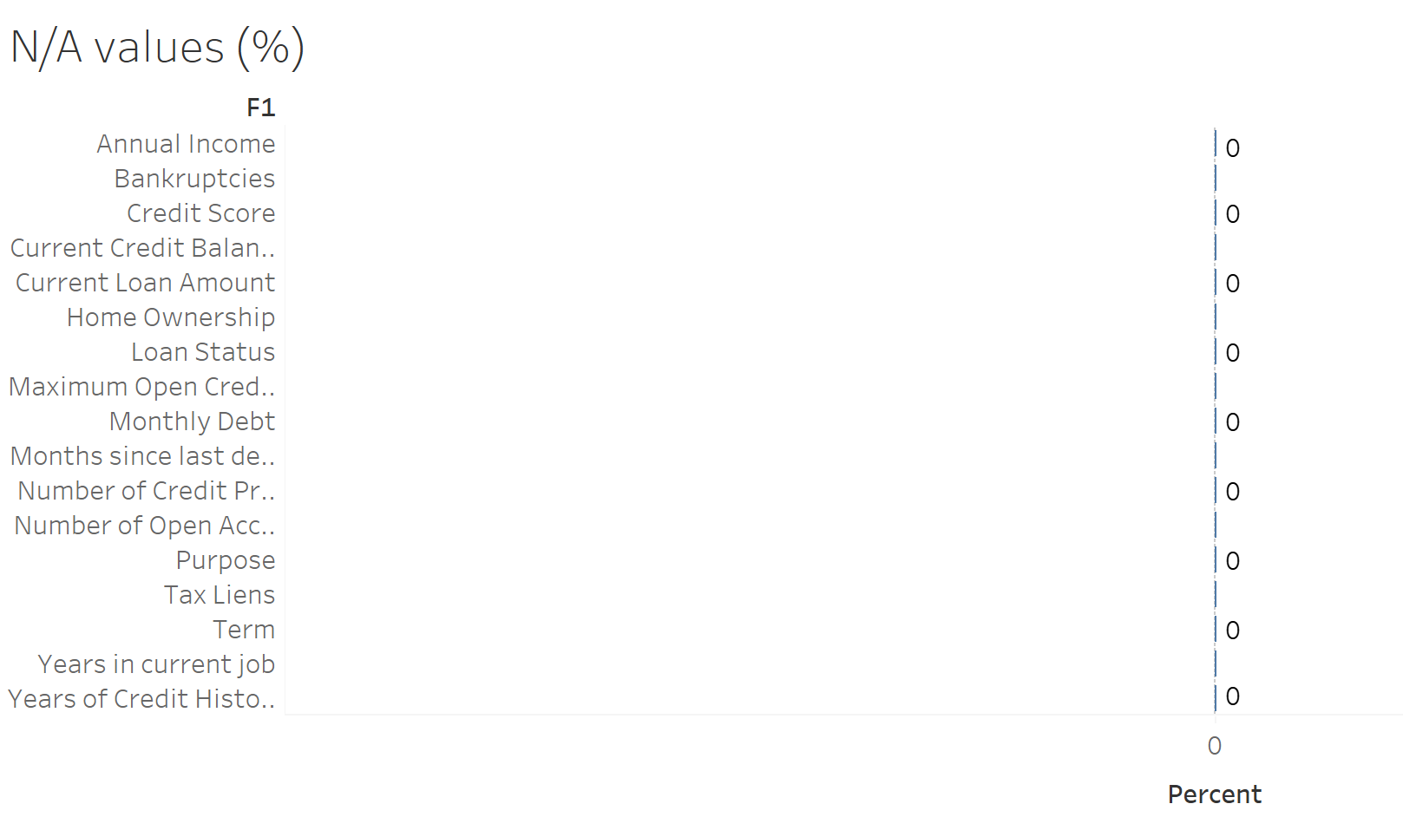

2.2. Data preparation
2.2.1. In this part, we need to find out all the NA values, duplicate values, and outliers
Fig 6. NA situation before and after
Handle the NA values
All the NA values have been handeled

Slide 14
2.2. Data preparation
2.2.1. In this part, we need to find out all the NA values, duplicate values, and outliers
10,215
Duplicated values
Handle the duplicated values
We see that the duplicate values ​​include both Loan ID and Customer ID. While this is the unique value
We will drop duplicated all these row

Slide 15
2.2. Data preparation
2.2.2. In this part, we change some columns from object to number type
Before | After
< 1 year | 0.5
1 year | 1
2 years | 2
3 years | 3
4 years | 4
5 years | 5
6 years | 6
7 years | 7
8 years | 8
9 years | 9
10 years | 10
11 years | 11
dtype: object | dtype: float
Change type of columns
We see that the Years in current job column is in object form and can be converted to numeric form without using a label encoder
With this, we can easily analyze in the following section

Slide 16
03
Exploratory Data Analysis

Slide 17
3. Exploratory Data Analysis
Target feature
Numerical feature
Describe and analyze the target variable
The distribution and proportion of the target variable values
Frequency and distribution of numerical values.
Descriptive statistics
Categorical feature
Insights and Initial Predictions
Frequency and distribution of categorical values.
Descriptive statistics
Relationships with the target variable
Predict the important features influencing the target variable.

Slide 18
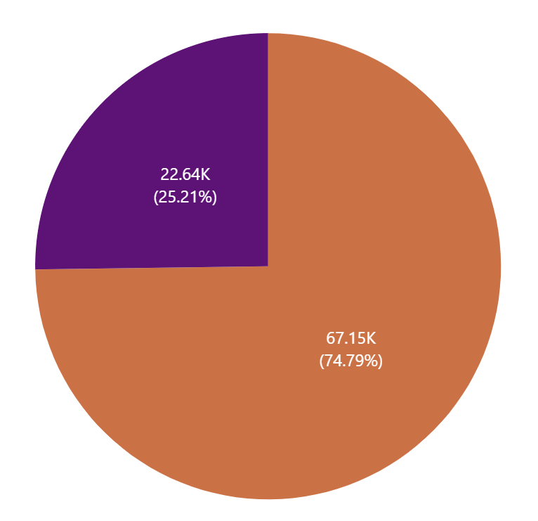
3.1. Target Feature
Conclusion:
Charged off
The chart shows that the amount of fully paid accounts for a large proportion, about 75%. The amount of charged off accounts for 25%
However, this is still a fairly large charged off rate and needs to be resolved.
This is almost an imbalance problem
Fully paid
Fig 7. Target feature distribution

Slide 19
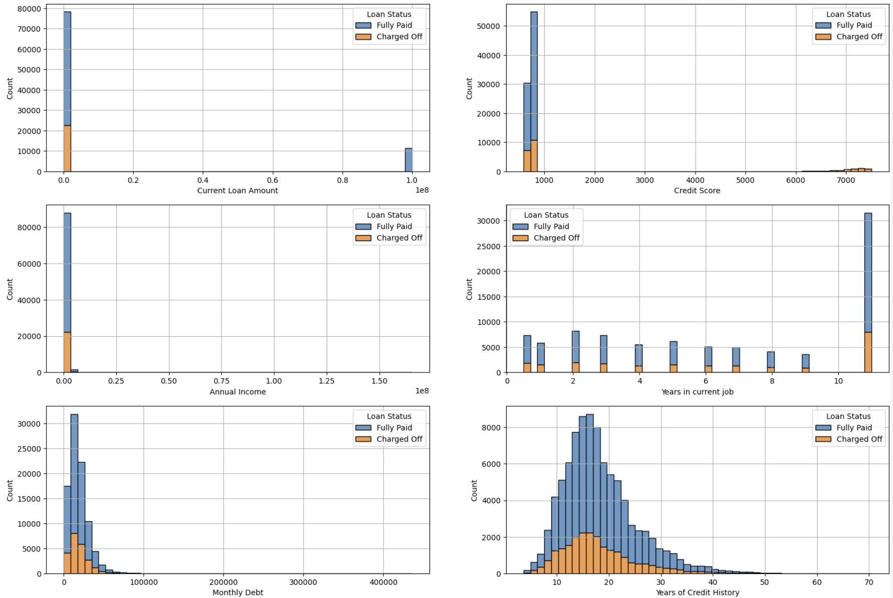
3.2. Numerical Feature
Conclusion:
Current Loan Amount: Most customers have low current loan amounts.
Credit Score: Most customers have very low credit scores. In particular, there are a few outliers larger than 6000 points, and they all charged off
Annual Income: Annual income is concentrated at a low level. Years in Current Job: The number of years working in the current job is distributed fairly evenly from 0 to 10 years.
Monthly Debt: Most customers have low monthly debt.
Years of Credit History: The number of years of credit history ranges from 5 to 20 years.
Fig 8. Numerical distribution

Slide 20
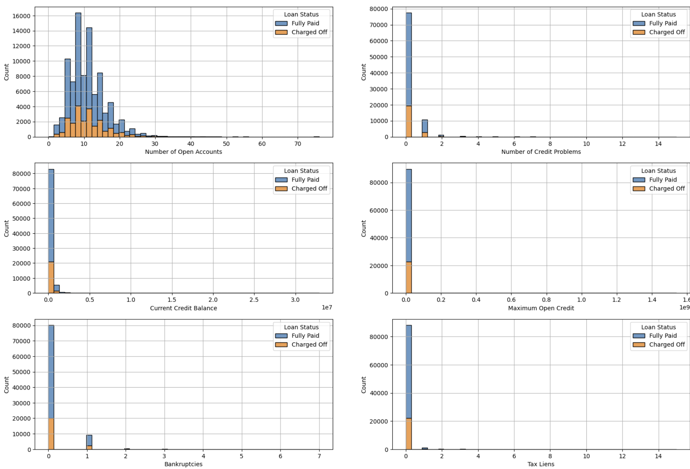
3.2 Numerical Feature
Conclusion:
The number of open accounts is uneven, concentrated in about 5 to 15 accounts.
Number of credit problems: Ranging from 0 to more than 14 problems, but focusing mainly on 0 problems.
Number of credit problem :Focus between 100K$ and 1M.
Maximum open credits: Concentrated between 10M and less than 50M
Tax Liens & Bankruptcies: Concentrated at level 0
Fig 8. Numerical distribution

Slide 21
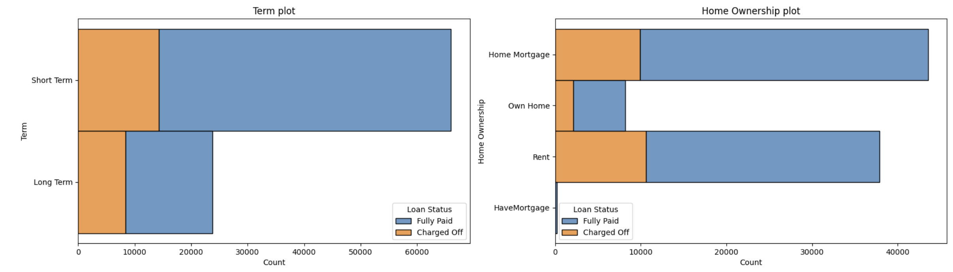
3.3. Categorical Feature
Conclusion:
Term :- Short-term loans account for the majority of the total loan, about 70k- The fully paid ratio of short-term loans is 4/5- Long-term loans are about 25k, fully paid rate is 2/3-> Short-term loans account for a larger proportion in both quantity and fully paid rate
Have Mortgage loans have the highest fully paid rate, about 90%, but the lowest data concentration compared to other types of loans- Home Mortgage loan has the second highest fully paid rate, about 80%, in addition this is also the type of loan with the largest number.- Own home and rent are two types with the same fully paid rate, about 70%, but Rent data is about 37k and ownhome is only about 10k
Fig 9. Categorical distribution

Slide 22
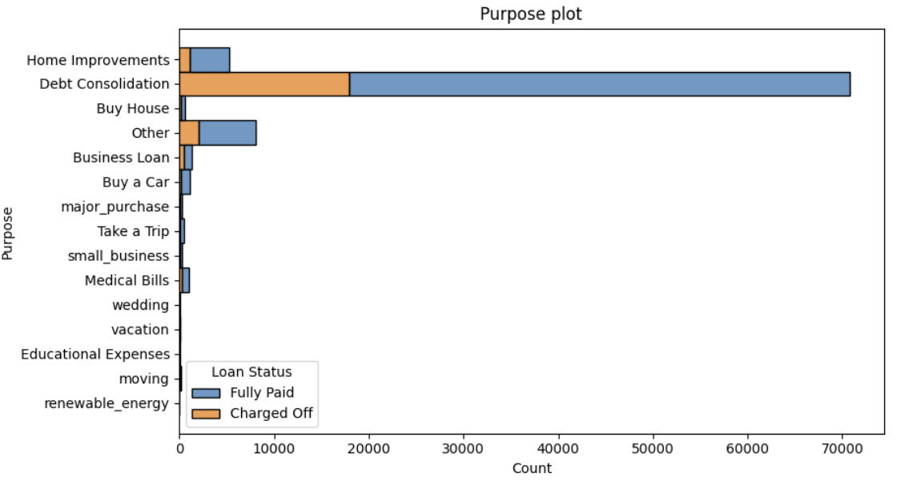
3.3. Categorical Feature
Conclusion:
The purpose of the loans focuses on small loans and consolidation (debt consolidation), in addition to other loans (Other) and home improvement (Home Repairation). Fully paid rate is quite high > 50%. “Small business, newable_energy” have a fully paid ratio of less than 60%, however these two account for the smallest proportion of loans
Fig 9. Categorical distribution

Slide 23
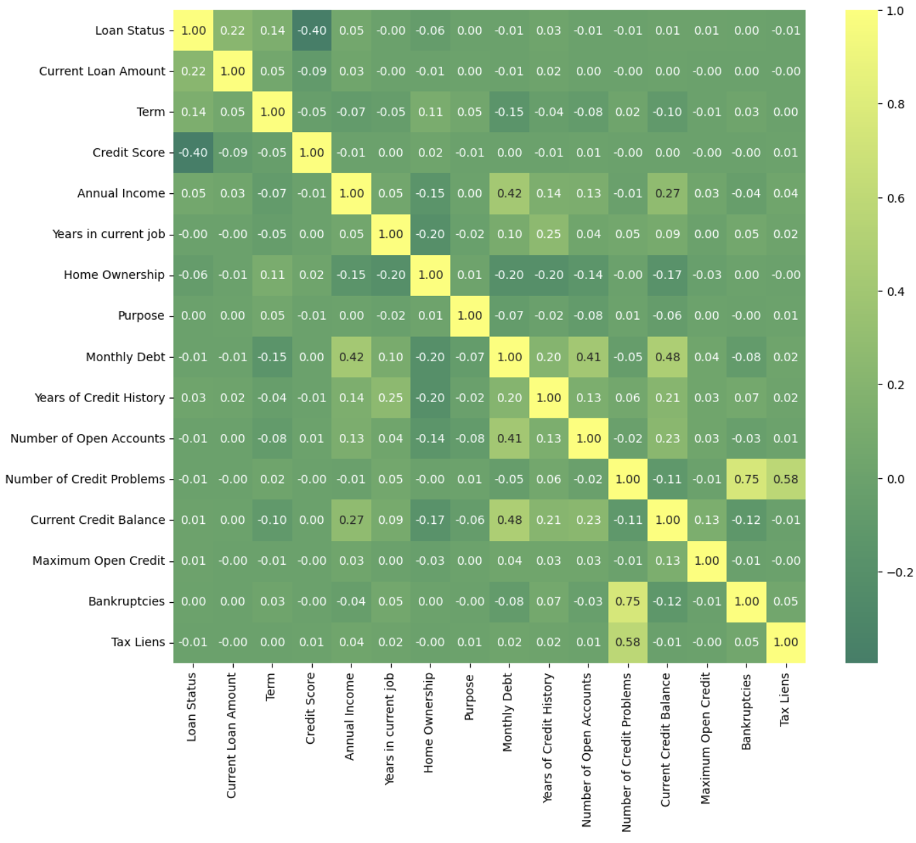
3.4. Insights and Initial Predictions
3.4.1.Heatmap
Fig 10. Heatmap

Slide 24
3.4. Insights and Initial Predictions
3.4.2. Insights and Initial Predictions of Current Loan Amount
Conclusion:
Current Loan Amount : The loan amount directly affects whether a person can repay the debt or not. The chart shows that there are very large debts, up to 10^8, almost 100% fully paid. So current loan and loan status are positively correlated. Current Loan is correlated to Loan Status by factors such as financial capacity. In other words, depending on the customer's financial situation customers, and the amount of money they borrow will directly affect Loan Status
Fig 11. Current Loan Amount distribution

Slide 25
3.4. Insights and Initial Predictions
3.4.3. Insights and Initial Predictions of Term
Conclusion:
Term : Loan term correlate with whether a customer can repay the debt or not. The chart shows that customers using short loan terms have a higher ability to repay than long-term loans. The number of customers using short loan terms accounts for a large proportion. So Term and Loan Status have a positive correlation. 80% of short loan term users have fully paid payment rate 65% of long loan term user users have fully paid payment rate
Fig 12. Term distribution

Slide 26
3.4. Insights and Initial Predictions
Conclusion:
3.4.4 Insights and Initial Predictions
Credit score has a strong correlation with whether a customer can repay their debt or not. However, Heatmap shows us that the chart shows a negative correlation between Credit Score and Loan Status. The reason comes from having a few unusually high credit scores (from 6000 or more) and these people are almost charged off.
So the graph has negative auto-correlation. If we remove
these points, we can see that the higher the credit score the higher the fully paid rate.
Fig 13. Credit Score distribution

Slide 27
04
Feature Selection & Modeling

Slide 28
4. Feature Selection & Modeling
In-Output & Splitting
Model selection
Select input(x) and output(y)
Train test split
Select the type of model.
Calculating Performance Metrics
Visualize and select model
Feature importance
Model Interpretability
- Calculate and visualize the feature importance
LIME and explanation

Slide 29
4.1. In-Output & Splitting
Categorical Feature
“Loan Status”
LabelEncoder()
LabelEncoder()
We need to convert the categorical variables and target variables into binary form to support model analysis
Conclusion:

Slide 30
4.1. In-Output & Splitting
Numerical Feature
Categorical Feature
‘Loan Status’
Input features X
Target Feature
Y
Input feature is all feature except ‘Loan Status’
Target feature is ‘Loan Status’
Conclusion:

Slide 31
4.1. In-Output & Splitting
Train_test_split()
x_train, x_test
y_train, y_test
StandardScaler()
x_train_scaled
x_test_scaled
In the previous step, we have change categorical to binary number. So we have to change numerical feature to standard scale
Conclusion:

Slide 32
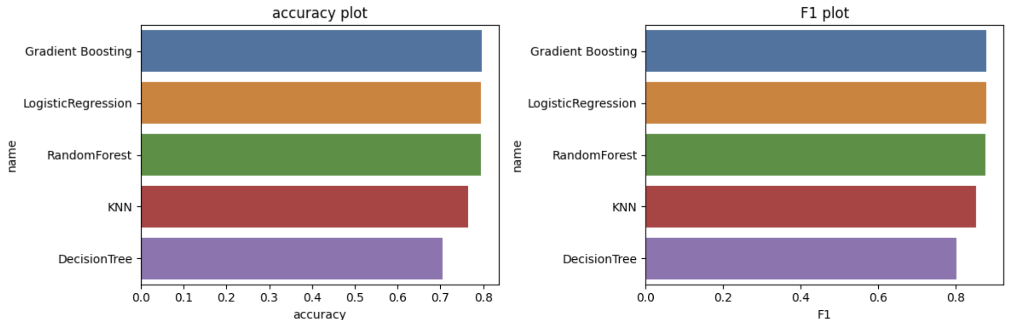
4.2. Model Selection
Fig 14. Model selection plot
It can be seen that the three methods Gradient Boosting, Logistic Regression and Random Forest all have the same and highest results.
Conclusion:

Slide 33
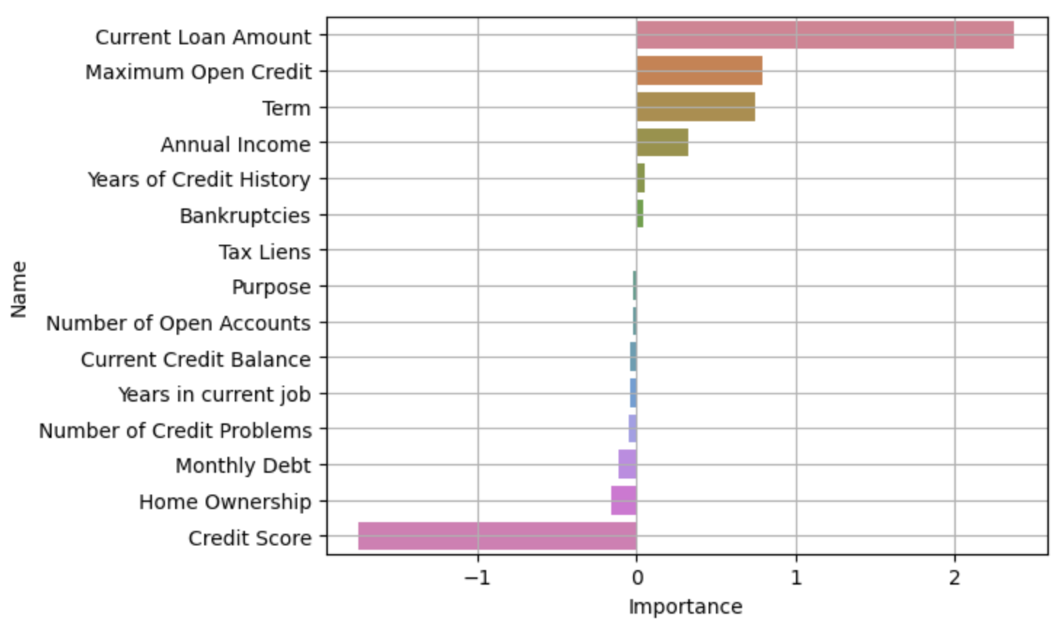
4.2. Feature importance
Fig 15. Importance feature of Logistic Regression plot

Slide 34
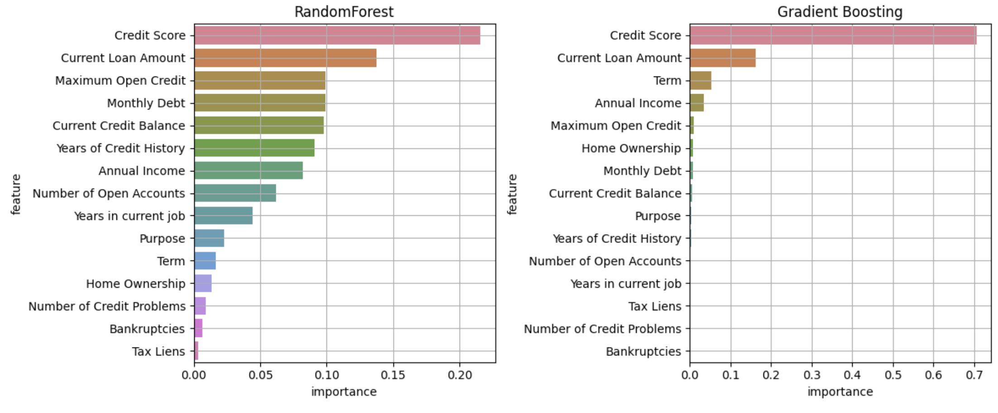
4.3. Feature importance
Fig 16. Importance feature of Random Forest Classifier plot
Fig 17. Importance feature of Gradient boosting classifier plot
According to the three plots, we can see that Credit Score, Current Loan Amount, and Term are the three features that have the greatest influence on the model.

Slide 35
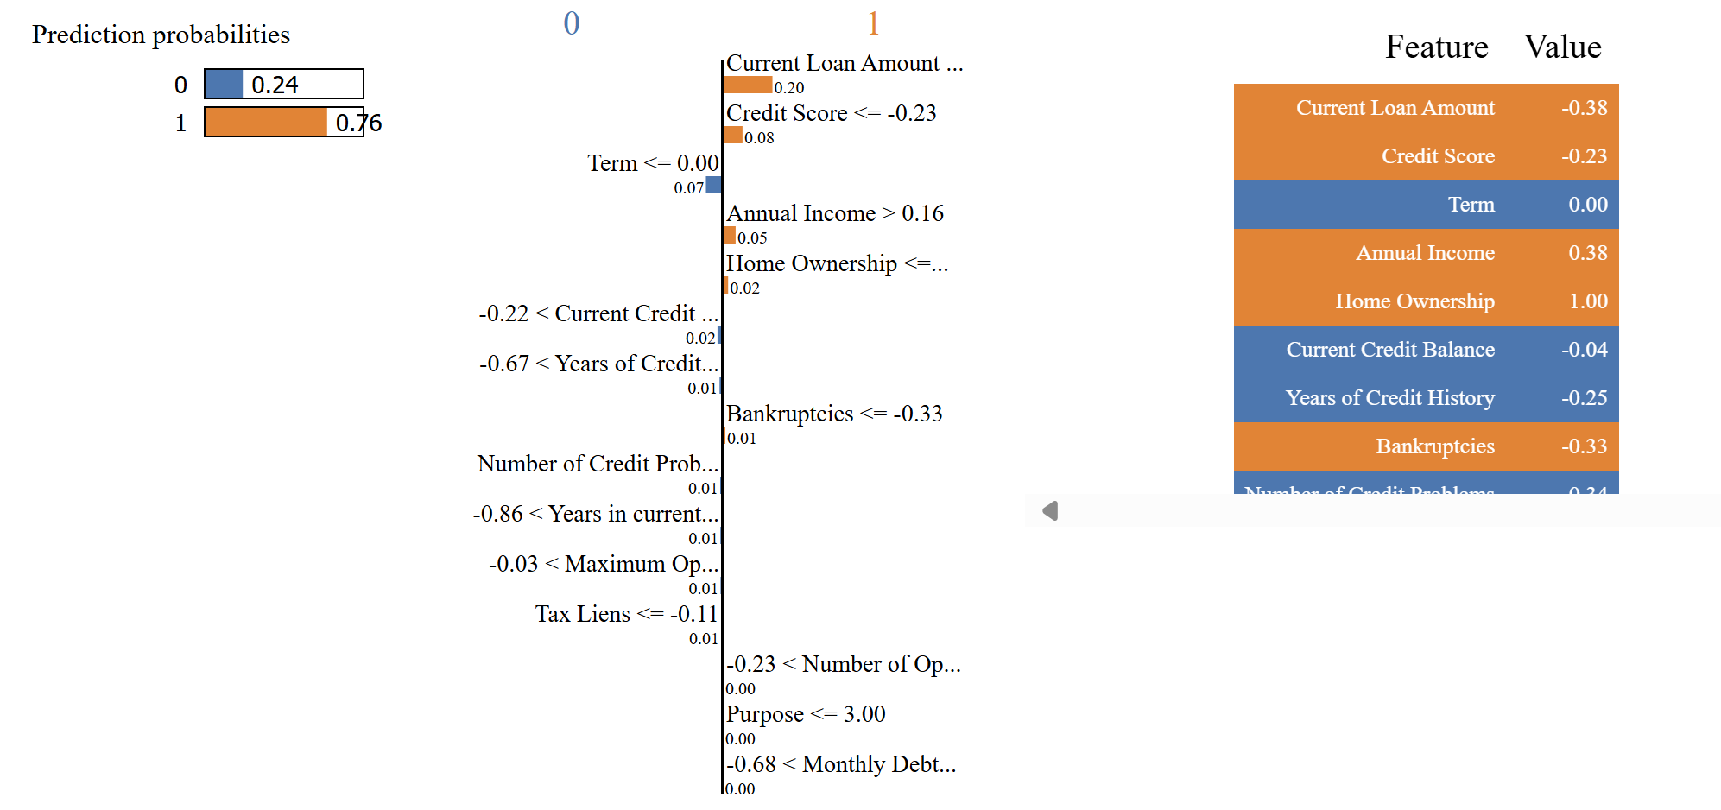
4.4. Model Interpretability
In row [0]:
Current loan amount contributes the most to the ‘grade 1’ prediction (0.20)
Credit score contributes the most to ‘grade 0’ -0.23
Annual income contribution to ‘grade 1’: 0.08

Slide 36
05
Result & Future work

Slide 37
5.1. Results
Conclusion:
1. Current Loan Amount:
Large loan amounts can pose a big challenge for customers with high monthly payments. Larger loans can lead to higher risks for customers who do not have enough financial capacity to ensure timely repayment.
2. Credit Score:
Credit score often reflects a customer's ability to repay debt. Customers with high credit scores often have better financial habits and have an easier time maintaining and repaying loans.
3. Term
Impact on interest costs: Long loan terms can result in higher interest costs, increasing the total cost of debt repayment over the long term. Loans with longer terms can make customers feel financial pressure, easily leading to not repaying the loan in full.
Financial management ability: Shorter loan terms can reduce the risk of loans, because customers can manage their finances and repay debt faster.
Term
Credit Score
Current Loan Amount

Slide 38
5.2. Future work and Recommendation
Current Loan Amount
Man
Technical
Method
Encourage employees to advise customers on loan options appropriate to their financial situation.
Help customers understand the impact of large loans on their personal finances and encourage them to choose a more suitable loan.
Deploy automated risk management systems to monitor and evaluate customers' financial situations in real time.
Use security and authentication technologies to ensure that loan transactions are safe and accurate.
Adjust loan policy:
Manage loans strictly
Strengthen credit checks

Slide 39
5.2. Future work and Recommendation
Credit Score
Man
Technical
Method
Check your credit score for abnormalities
Financial counseling skills: Train staff to advise customers on how to improve their credit scores and the impact of low credit scores on loan terms.
Hỗ trợ khách hàng: Hỗ trợ khách hàng có điểm tín dụng thấp bằng cách cung cấp các dịch vụ tư vấn tài chính cá nhân, giúp họ hiểu cách cải thiện điểm tín dụng và quản lý tài chính cá nhân hiệu quả.
Real-time monitoring and analysis: Use real-time credit monitoring systems to continuously update and analyze customer credit scores, thereby detecting potential risks early.
Adjust loan policy based on credit score:
Stratification policy: Apply stratification policies, meaning offering different loan conditions based on the customer's credit score. Customers with high credit scores will receive more favorable loan conditions.
Warranties: Require security conditions for customers with low credit scores, such as requiring collateral or guarantees.

Slide 40
5.2. Future work and Recommendation
Term
Man
Technical
Method
Staff should be trained to advise customers on different loan term options and help them understand the financial implications of each option.
Real-time tracking and analysis: Use systems to track and analyze loan terms in real-time to update and predict related risks.
Automatic evaluation system: Apply automatic systems to evaluate the appropriate loan term based on the customer's financial situation and credit history.
Flexible loan term policy: Provides flexible loan term options to suit each customer's needs and repayment ability. This may include shorter term options for high-risk customers.
Adjust interest rate according to loan term: Adjust interest rate based on loan term to encourage customers to choose a shorter loan term if they can repay the loan faster.

Slide 41

Thanks!
Do you have any questions?
Namqt.hust@gmail.com
+84 343061414
Please keep this slide for attribution

Slide 42
Alternative resources
Source code : Bank Loan Status Dataset (kaggle.com)

